Slide 1
Machine Learning Project
Name - Vineet Kumar
Learnbay 25th Nov 2023 batch

Slide 2
Project Title
Comprehensive Water Quality Assessment and Potability Prediction using Multi-parameter Analysis

Slide 3
Introduction
This machine learning problem aims to predict water potability based on provided water quality parameters. By analyzing relevant features, the objective is to develop a model that classifies water samples as meeting or not meeting potability standards. The significance lies in ensuring the safety of water for consumption, contributing to environmental and public health concerns.

Slide 4
Problem Statement
This machine learning problem seeks to predict water potability by analyzing a set of water quality parameters. The goal is to determine whether the provided features indicate compliance with potability criteria, highlighting the importance of ensuring safe water for consumption.

Slide 5
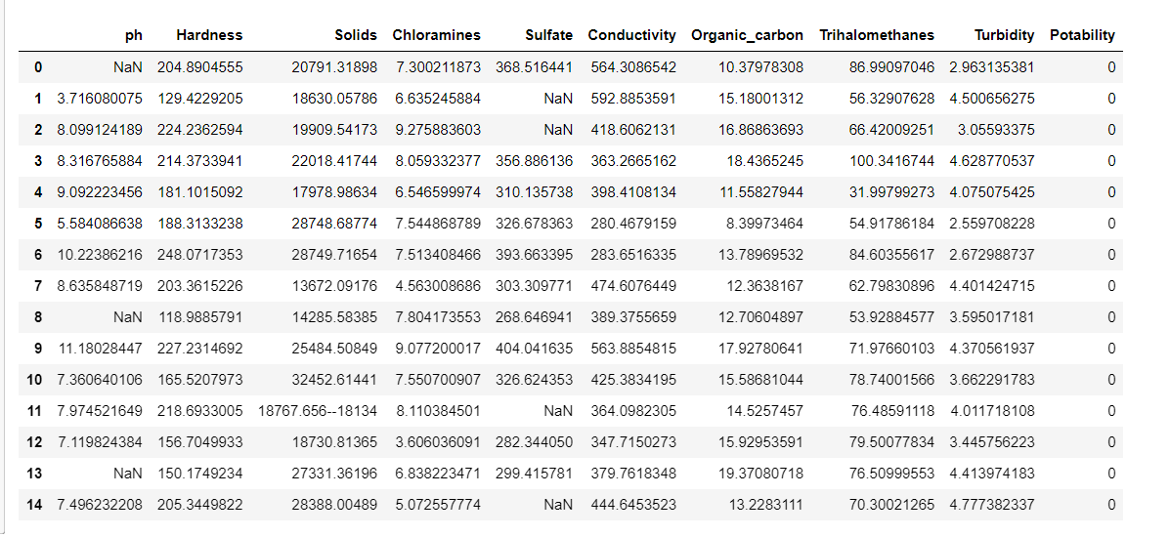
Overview of Dataframe

Slide 6
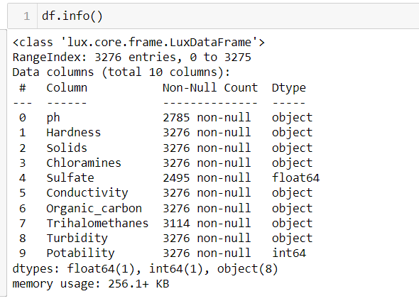
Summary of DataFrame

Slide 7
Data Preprocessing
Data Cleaning
Data Exploration
Data Transformation
Dealing with Imbalanced Data
Data Splitting

Slide 8
Data Cleaning
Defined a versatile cleaning function, clean_value, to handle diverse data types.
Removed non-numeric characters, keeping only numeric, '.', and '-'.
Attempted to convert the cleaned string to a float, returning None if the process failed.
Applied the cleaning function uniformly to all columns in the dataset.
Improved data consistency via common numeric format.
Gracefully managed potential errors during cleaning.
Adaptable cleaning function for diverse data structures.

Slide 9
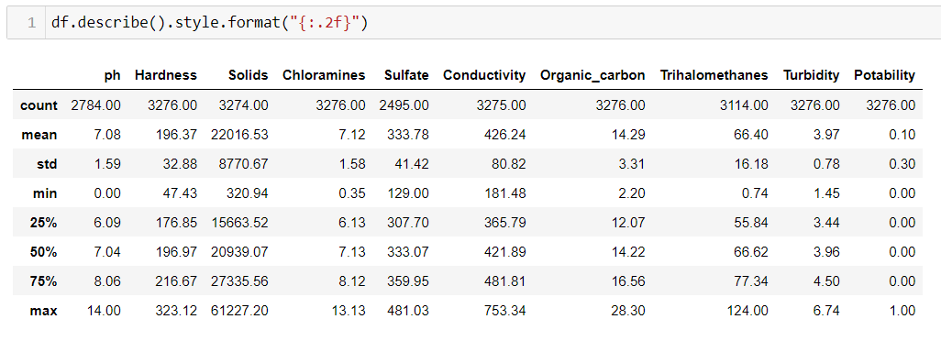
Descriptive statistics after cleaning

Slide 10
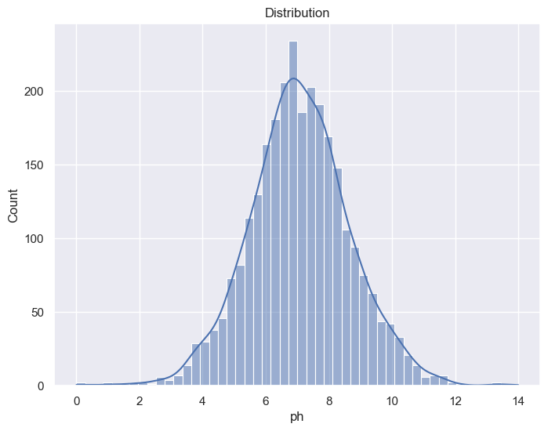
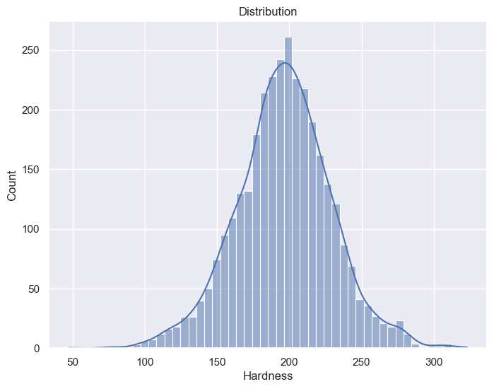
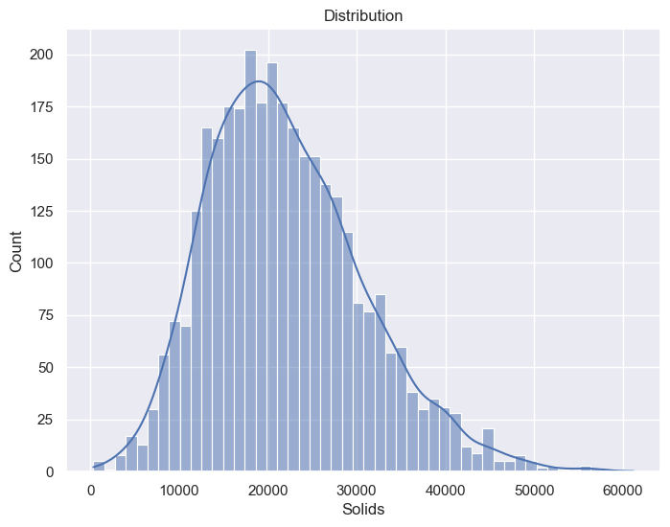
Data Exploration
Visualize data distributions and relationships between variables to gain insights.

Slide 11
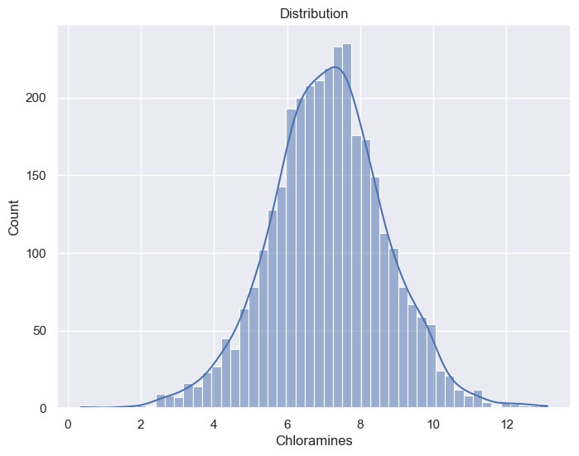
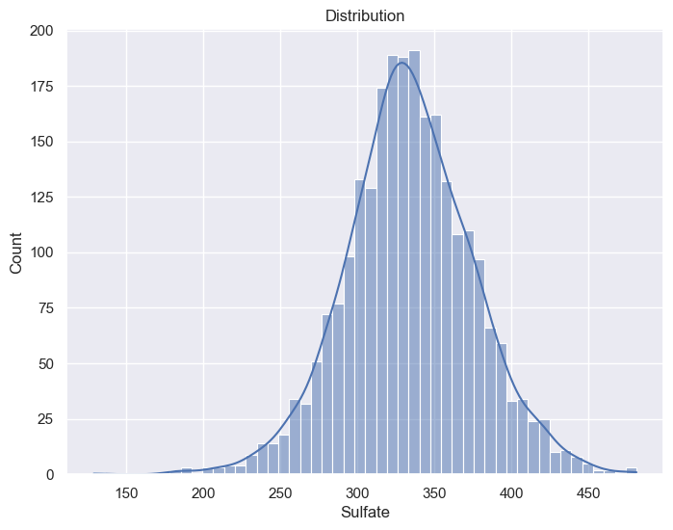
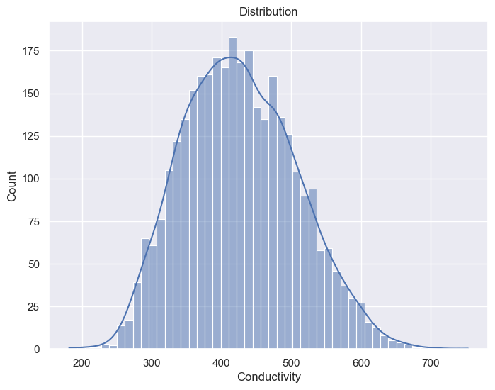
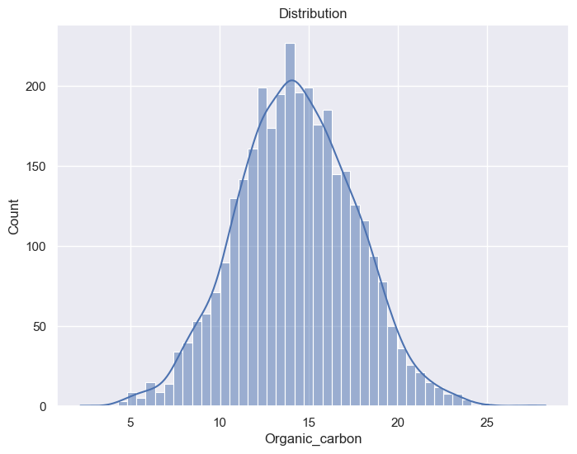
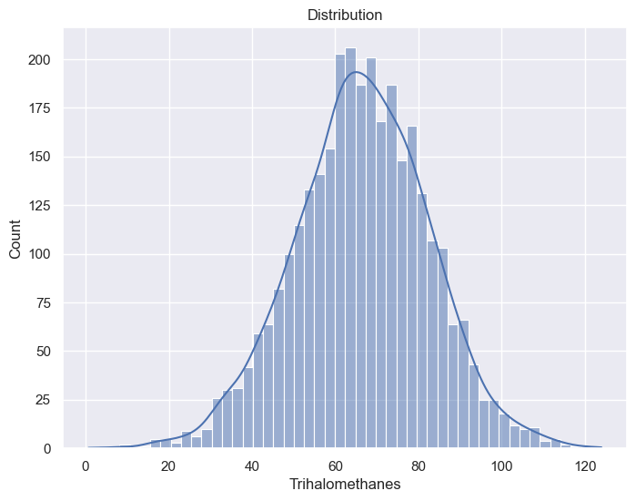
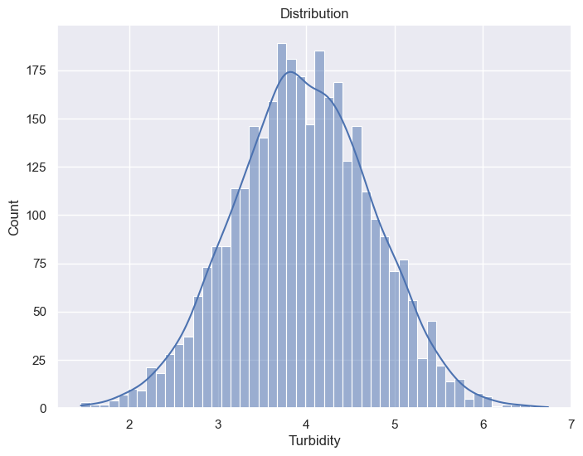

Slide 12
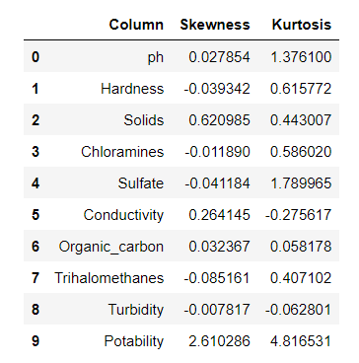
Skewness and Kurtosis
ph
Slight right skewness with a moderately peaked distribution.
Hardness:
Slightly left-skewed with a moderate peak.
Solids
Positively skewed, indicating a longer right tail.
Chloramines
Nearly symmetric distribution with a moderate peak.
Sulfate
Slightly left-skewed with a moderately peaked distribution.
Conductivity
Positively skewed, tending to the right, with a flat peak.
Organic_carbon
Slightly right-skewed with a low peak.
Trihalomethanes
Left-skewed with a moderate peak.
Turbidity
Slightly left-skewed with a flat peak.

Slide 13
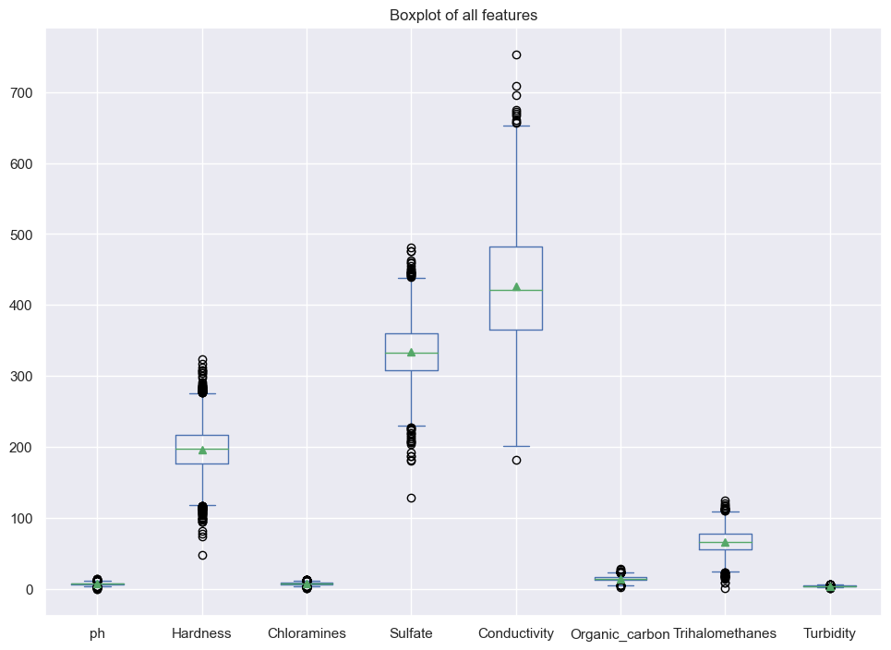
Boxplot for Features
Chose an approach that keeps outliers, seeing them as valuable data points, for a deeper grasp of dataset patterns.

Slide 14
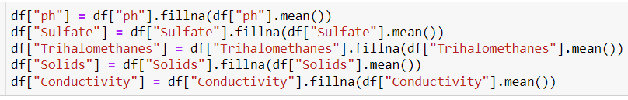
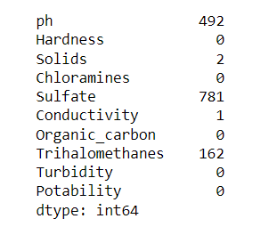
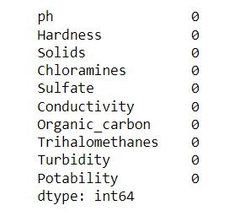
Handling Missing Values
Filling in Missing Values by Utilizing the Mean of Respective Features.

Slide 15
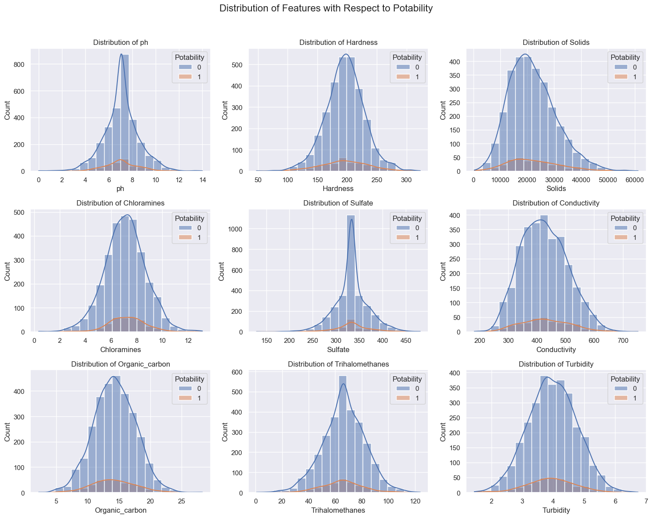
Distribution of Features with respect to Potability

Slide 16
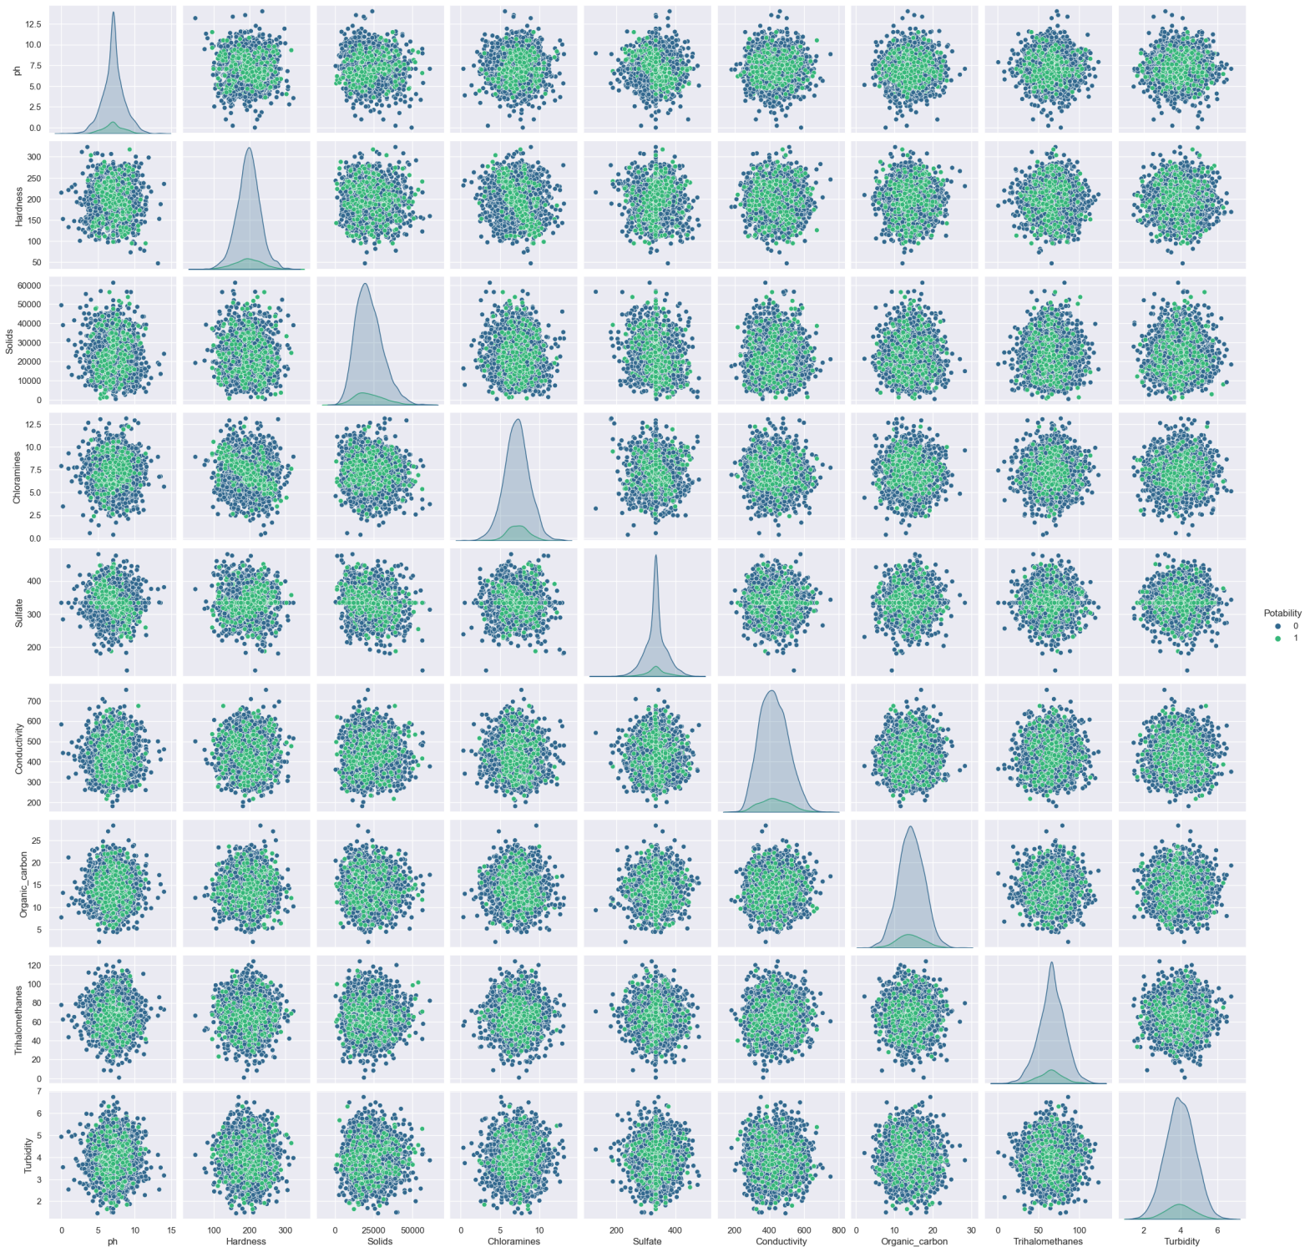
Pairplot

Slide 17
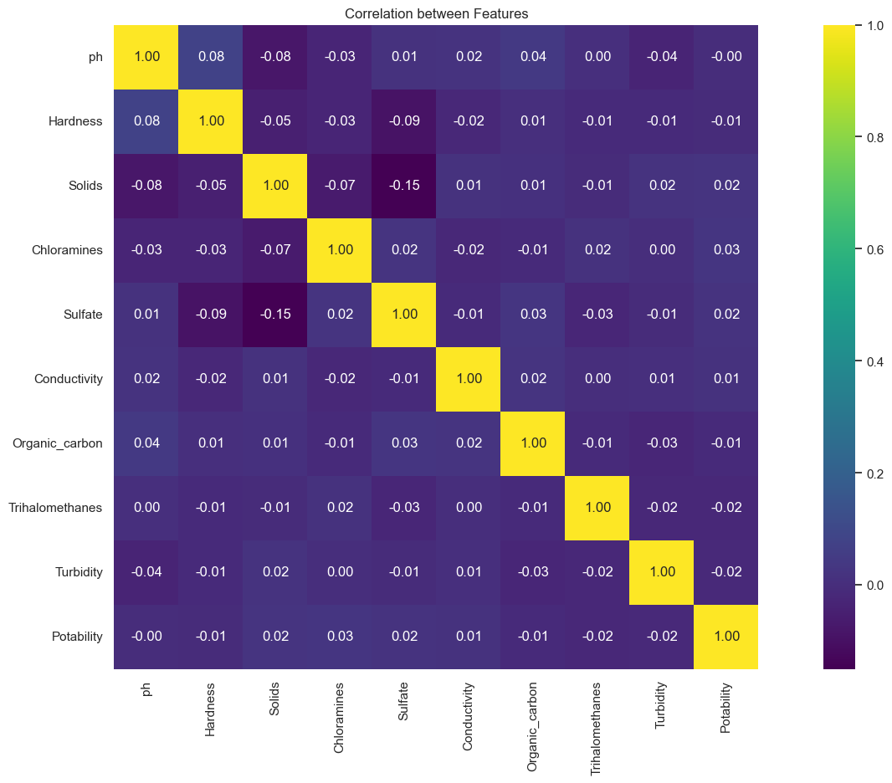
Feature Correlation

Slide 18
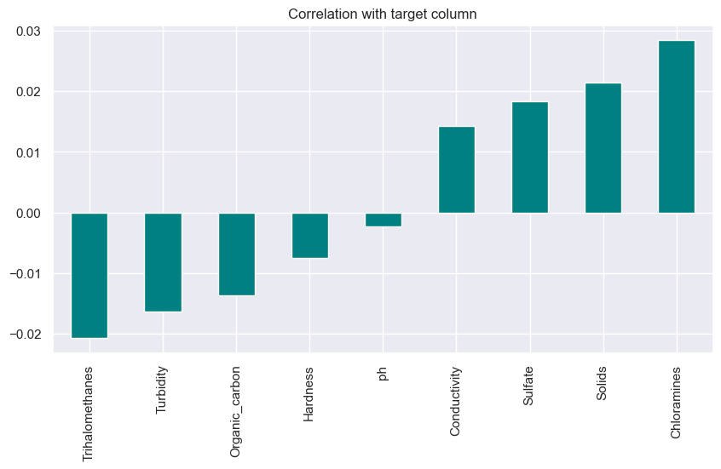
Correlation with the target column

Slide 19

Data Scaling by Standardization
Significance of Data Scaling
Ensures fair comparison, avoiding dominance by any single feature.
Speeds up and stabilizes machine learning model training.
Minimizes the impact of outliers for a more robust analysis.
Improves the interpretability of model coefficients, especially in linear models.
Boosts overall model performance, especially in algorithms sensitive to scale.
Aids algorithms using distance metrics, ensuring meaningful calculations.
Speeds up convergence in iterative algorithms like gradient descent.
Facilitates easy comparison of features with different units or scales.

Slide 20
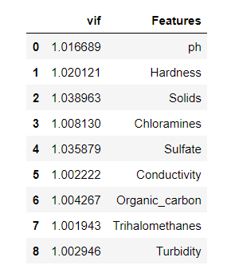
Variance Inflation Factor (VIF)
Importance of VIF
Multicollinearity Detection
Model Stability
Feature Importance
Precision and Accuracy
Optimized Feature Selection
Assumption Validation
Avoidance of Overfitting
Improved Interpretability

Slide 21
Creating Train and Test Sets
Utilized the train_test_split function from scikit-learn.
Divided the dataset into training and testing sets.
Employed oversampling (RandomOverSampler) to address class imbalance.
Ensured a representative distribution of target classes in both training and testing sets.
Selected a test size of 25% to allocate a substantial portion for model evaluation.
Set a random seed (random_state=101) for reproducibility.
Facilitated robust model training and evaluation by balancing class distribution in the datasets.

Slide 22
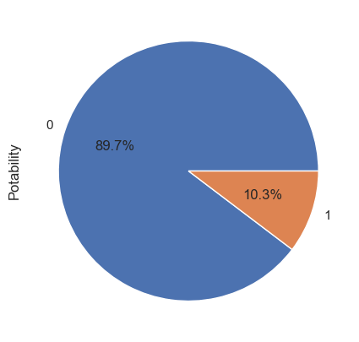
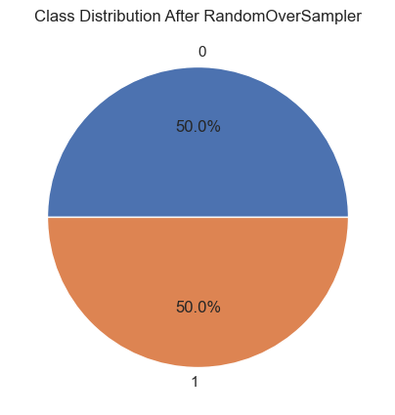
Balancing Classes with RandomOverSampler
Applied RandomOverSampler for class imbalance.
Achieved balanced representation in training and testing.
Alleviated skewed class impact on model training.
Before
After

Slide 23
Machine Learning Models
LogisticRegression: A linear classification model.
GaussianNB: A Gaussian Naive Bayes classifier for probabilistic classification.
SVC: Support Vector Classifier for classification tasks.
DecisionTreeClassifier: A decision tree-based classifier.
RandomForestClassifier: A random forest ensemble classifier.
AdaBoostClassifier: A classifier using AdaBoost boosting technique.
GradientBoostingClassifier: A classifier using gradient boosting.
XGBClassifier: XGBoost, a popular gradient boosting library for classification and regression tasks.

Slide 24
Model Evaluation and Comparison
Cross-validation:
Model is assessed for generalization using 5-fold cross-validation on the test dataset.
Training:
Model is trained on the entire training dataset (x_train and y_train).
Predictions:
Predictions are generated for both the training and testing datasets.
Evaluation Metrics:
Train Accuracy
Test Accuracy
Precision
Recall
F1 Score
ROC AUC Score

Slide 25
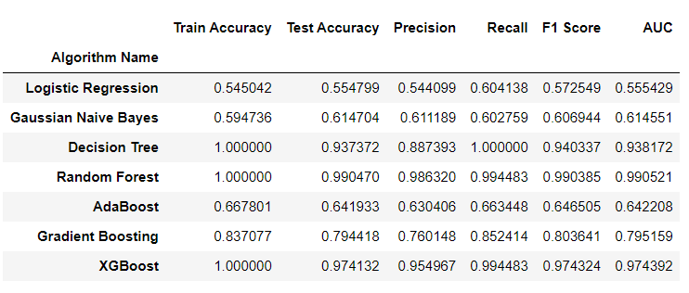
Evaluation Results

Slide 26
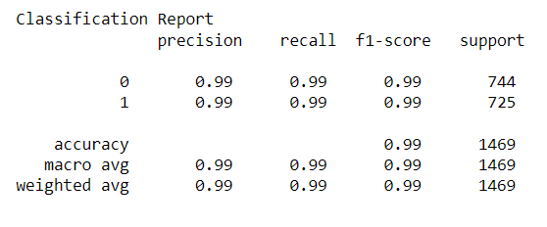
Final Model using RandomForest
Performs well with nearly 100% accuracy on the training set and around 99% on the test set. It has high precision, recall, F1 score, and AUC, suggesting a robust model.

Slide 27
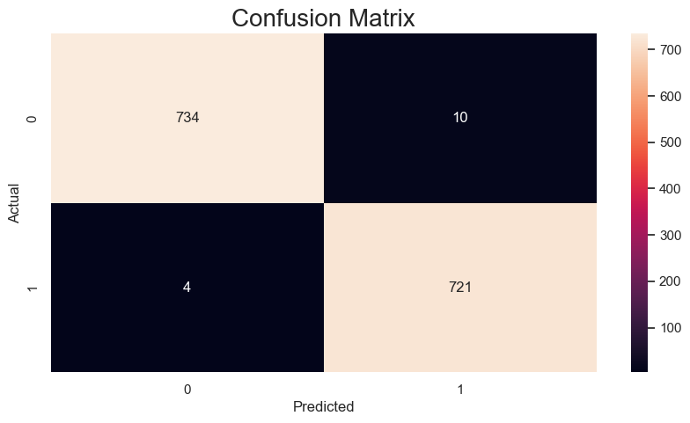
Confusion Matrix

Slide 28
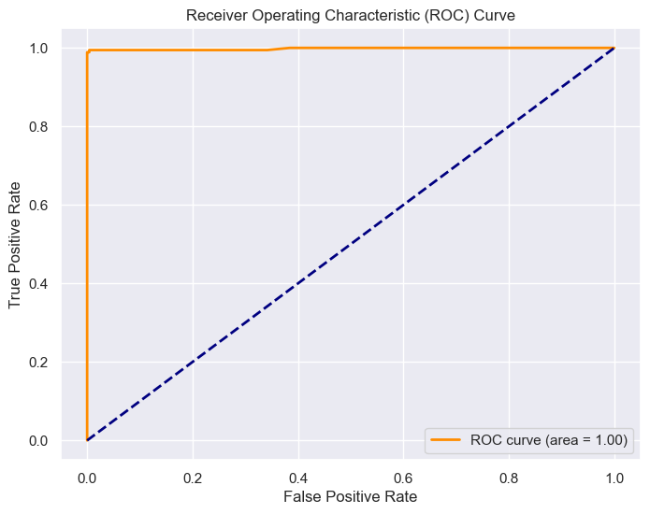
ROC Curve

Slide 29
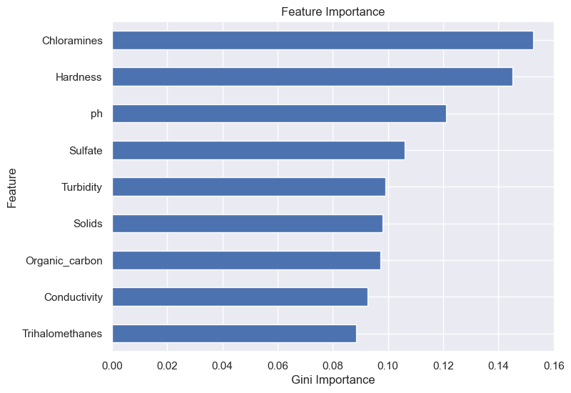
Feature Importance

Slide 30
THANK YOU

